Slide 1


DEPARTMENT OF COMPUTER SCIENCE AND ENGINEERING
20CS7503 & DESIGN PROJECT 3
END SEMESTER PRACTICAL EXAMINATION- NOV / DEC 2025
REVIEW PRESENTATION
Batch No: 1
Date: 29.11.2025
Session: FN

Slide 2
TITLE OF THE PROJECT
AI-POWERED CARDIOVASCULAR HEART DISEASE DETECTION USING MACHINE LEARNING
Guide Name:
Mr. DEVAN D.P.,M.E.,
Team Members:
K.SHALINI [811722104139]
V.G SOWMIYA [811722104150]
S.SUBHIKA [811722104158]

Slide 3
OBJECTIVE OF THE PROJECT
Identify heart disease risk at an early stage using clinical features (age, cholesterol, blood pressure, diabetes, etc.).
Classify ECG signals and images into specific cardiac conditions (Normal, MI, Abnormal, HistoryMI).
Fuse outputs from tabular, signal, and image models to determine a unified risk level (Low / Medium / High).
Provide tailored medical advice to patients and healthcare providers based on the assessed risk.
Assist cardiologists in decision-making, reduce misdiagnosis, and enable efficient patient monitoring in both clinical and remote healthcare environments.

Slide 4
INTRODUCTION
Heart disease remains one of the leading causes of death worldwide, making early and accurate detection vital.
Traditional methods rely on clinical features or ECG interpretation alone, which may lead to misdiagnosis.
Artificial Intelligence (AI) and Machine Learning (ML) enable powerful multi-modal analysis of clinical data, ECG signals, and ECG images.
This project, that integrates these modalities to predict risk levels, classify diseases, and provide medical recommendations.
The system aims to support cardiologists in decision-making and improve patient monitoring in both clinical and remote healthcare settings.

Slide 5
LITERATURE SURVEY
TITLE OF PAPER | AUTHORS | PAPER GIST | TECHNOLOGY USED
HXAI-ML: A Hybrid Explainable Artificial Intelligence Model for Cardiovascular Heart Disease Detection | Md. Alamin Talukder Amira Samy Talaat Mohsin Kazi | Hybrid XAI model for accurate, transparent heart disease detection. | Machine Learning, Explainable AI (XAI), Hybrid Models
A multimodal machine learning approach for cardiovascular disease prediction using clinical data and ECG signals | S. Shashikumar, Q. Li, M. Clifford | Combines ECG and clinical data for better heart disease prediction. | Machine Learning (Random Forest, XGBoost)
Deep learning-based classification of ECG signals for diagnosis of cardiac arrhythmia | Hannun, P. Rajpurkar | CNN-based ECG classification for arrhythmia diagnosis. | D Convolutional Neural Networks (CNN)

Slide 6
LITERATURE SURVEY
TITLE OF PAPER | AUTHORS | PAPER GIST | TECHNOLOGY USED
Cardiovascular disease identification using a hybrid CNN-LSTM model with explainable AI | Md. Maruf Hossain, Md Shahin Ali | Hybrid deep model with XAI for cardiovascular disease detection | Hybrid deep learning (CNN + LSTM), feature engineering
Interpretable estimation of the risk of heart failure hospitalization from a 30-second electrocardiogram | Sergio González, Wan-Ting Hsieh | SHAP-based model predicts heart failure risk from ECG. | Machine learning, SHAP, survival modeling based on single-lead ECG for predicting heart failure

Slide 7
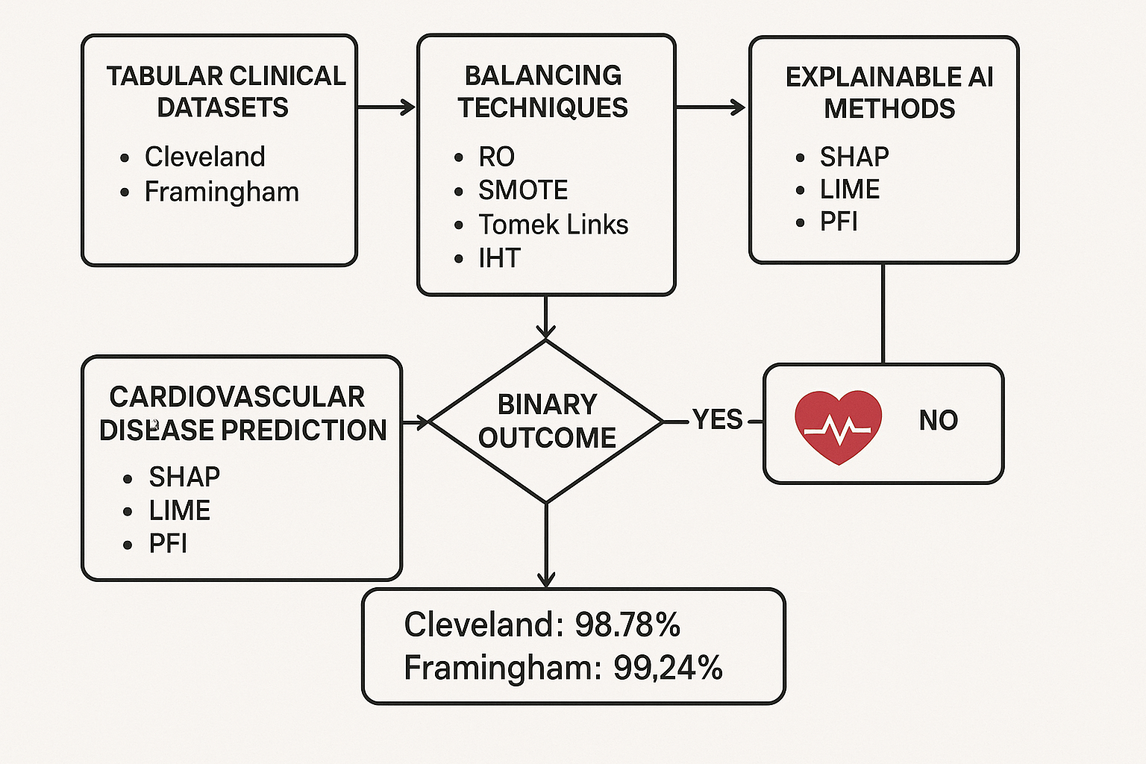
EXISTING SYSTEM ARCHITECTURE

Slide 8
PROBLEM IDENTIFICATION
Existing models rely only on tabular clinical data (e.g., age, cholesterol, BP), ignoring ECG signals and images, thus missing critical physiological and electrical heart information.
The current system provides only a Yes/No result, failing to represent different disease risk levels essential for clinical decision-making and early intervention.
Though XAI methods like SHAP, LIME, and PFI are applied, interpretation remains limited to tabular features, lacking multimodal explainability from ECG data
Despite using RO, SMOTE, Tomek Links, and IHT, real-world data imbalance still affects model generalization and consistency across varied patient groups.
The model only predicts disease presence or absence without providing patient-specific recommendations or insights for preventive healthcare actions.

Slide 9
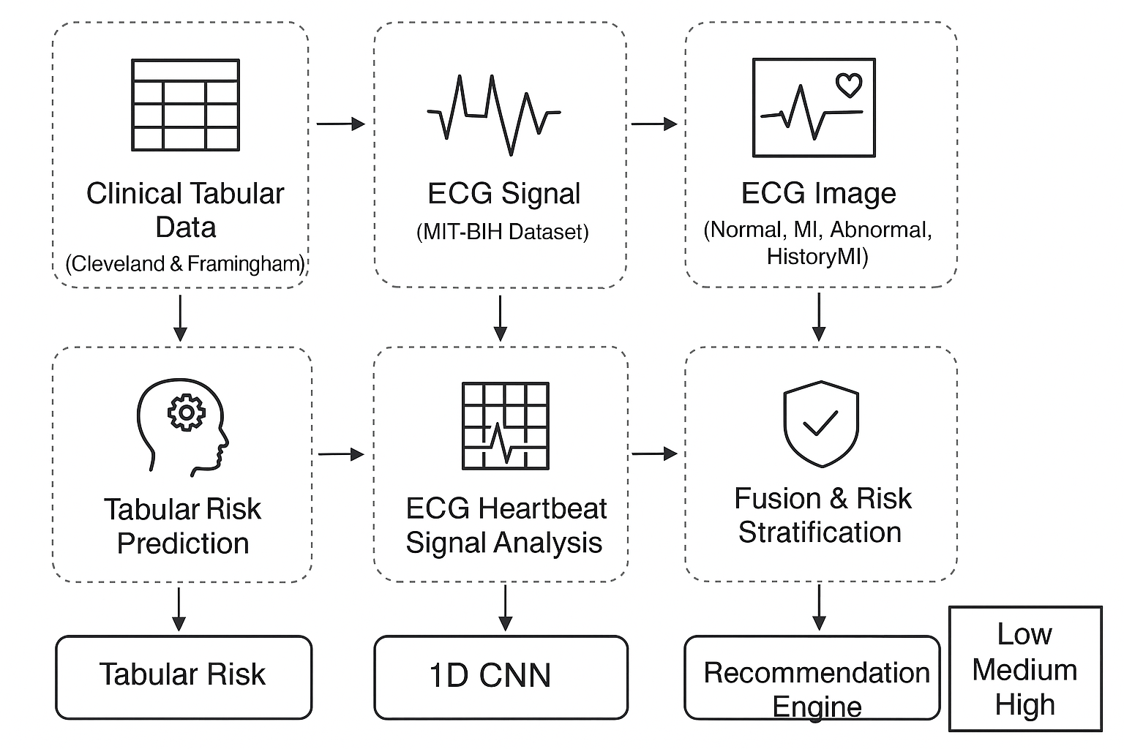
PROPOSED SYSTEM ARCHITECTURE

Slide 10
SOFTWARE AND HARDWARE REQUIREMENTS
HARDWARE
Processor: i5/Ryzen5+
RAM: 8GB+
GPU: NVIDIA/Colab
Storage: 50GB+
Peripherals: Standard
SOFTWARE
OS: Windows/Colab
Language: Python
Libraries: Scikit-learn, TensorFlow, Keras, Pandas, NumPy, Matplotlib, Gradio/Streamlit
Database: CSV
IDE: Jupyter/Colab/PyCharm

Slide 11
MODULES
Tabular Risk Prediction (Cleveland & Framingham)
ECG Heartbeat Signal Analysis (MIT-BIH Dataset)
ECG Image Analysis (Normal, MI, Abnormal, HistoryMI)
Fusion & Risk Stratification
Recommendation Engine

Slide 12
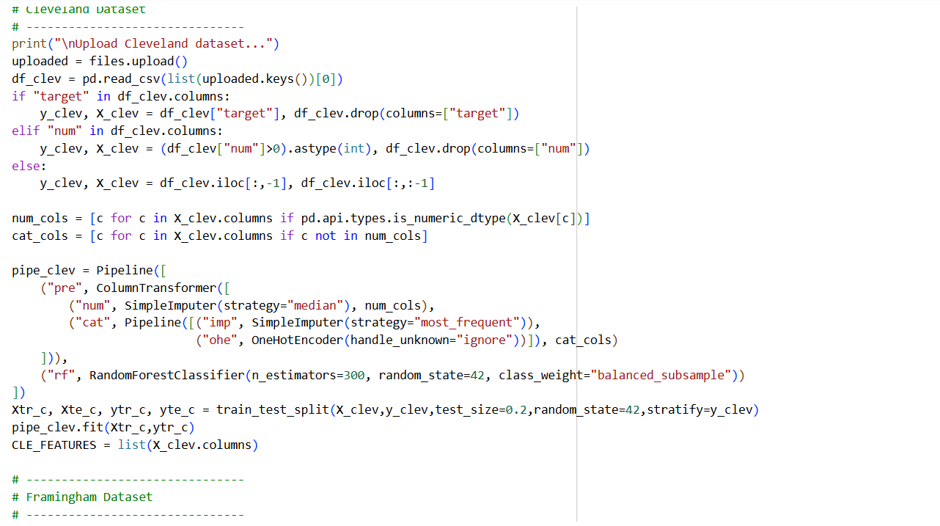
IMPLEMENTATION OF MODULE-1
Preprocess Cleveland & Framingham clinical data (handle missing values, normalize, encode) and train a Random Forest.
Predict heart disease probability (0–100%) and classify risk as Low, Medium, or High.

Slide 13
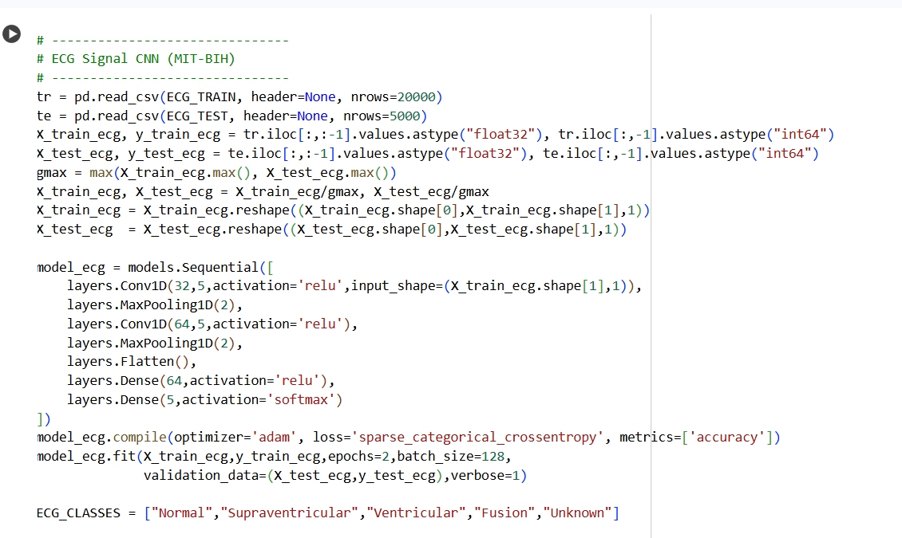
IMPLEMENTATION OF MODULE-2
Raw ECG signals from MIT-BIH are normalized, reshaped, and classified using a 1D CNN into Normal, Supraventricular, Ventricular, Fusion, or Unknown classes.
Each class is mapped to a risk level: Normal → Low, Supraventricular/Unknown → Medium, Ventricular/Fusion → High.

Slide 14
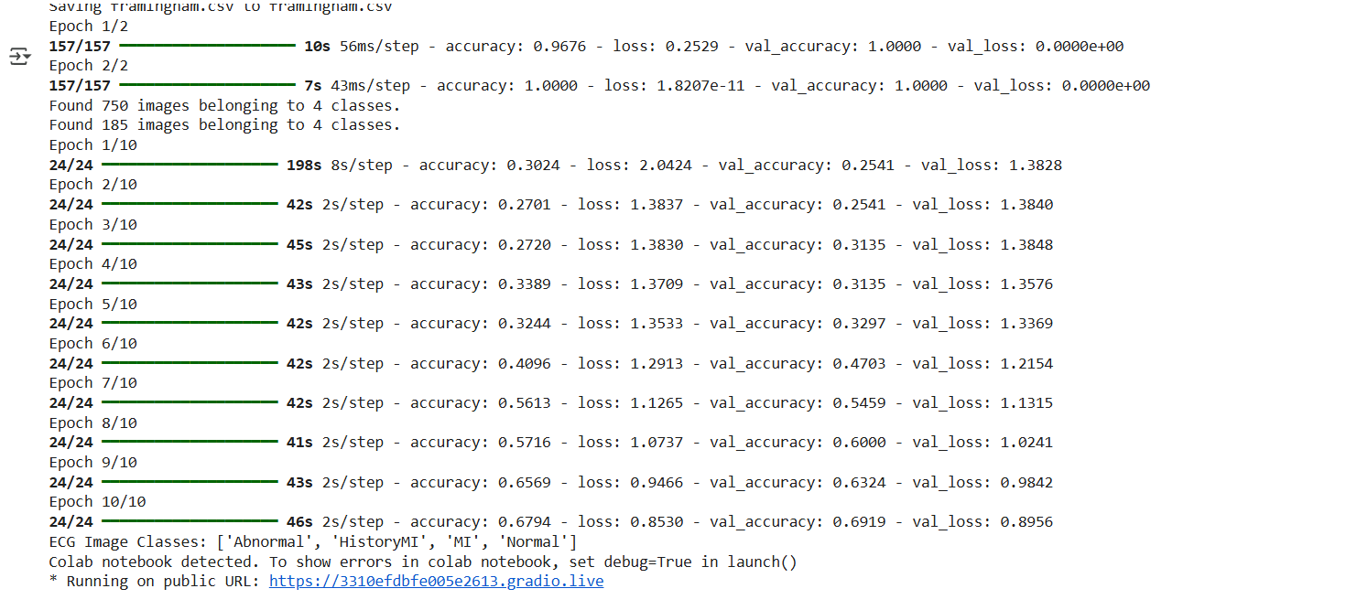
IMPLEMENTATION OF MODULE-3
ECG images are preprocessed (grayscale, resize, normalize) and classified using a 2D CNN into Normal, MI, Abnormal, or HistoryMI.
Each class is mapped to a risk level with explanation: Normal → Low, MI → High, Abnormal/HistoryMI → Medium.

Slide 15
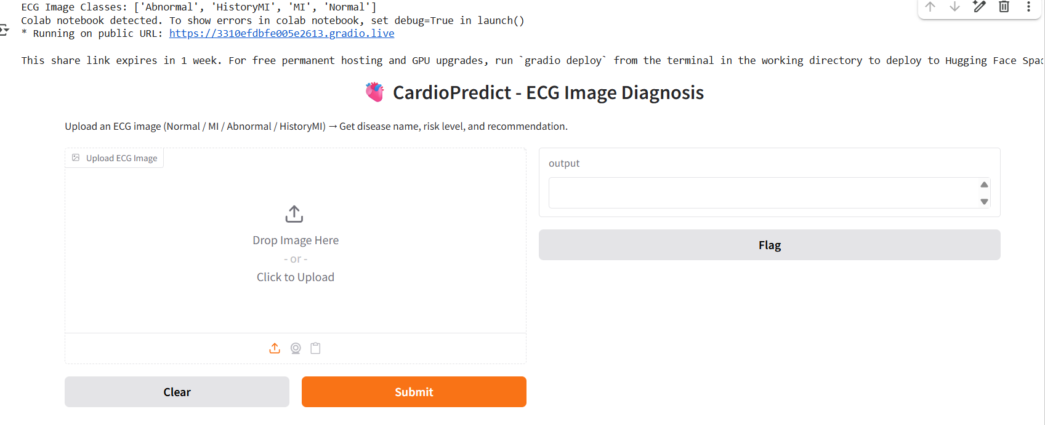
IMPLEMENTATION OF MODULE-4
Combines tabular, ECG signal, and ECG image predictions using a fusion rule that takes the highest severity among them.
Final output is a unified risk level: High if any module predicts High, else Medium if any predicts Medium, otherwise Low.

Slide 16
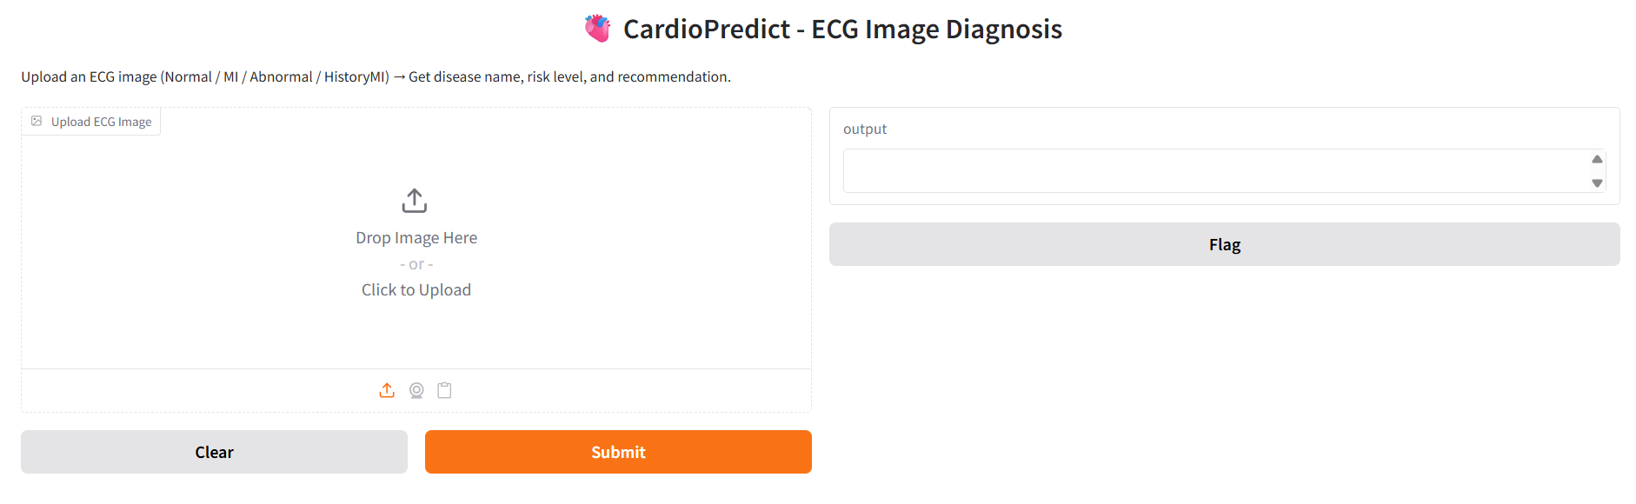
IMPLEMENTATION OF MODULE-5
Takes the final fused risk level as input and applies simple if–else rules.
Provides plain-text medical recommendations: Low → Healthy lifestyle, Medium → Consultation soon, High → Immediate cardiologist visit.

Slide 17
CONCLUSION
This detection integrates clinical data, ECG signals, and ECG images to provide multi-class disease detection and stratify patients into Low, Medium, or High risk categories for more accurate prediction.
The system fuses information from all modalities and delivers personalized recommendations, enabling early diagnosis, reducing misdiagnosis, and supporting both clinical and remote patient monitoring.

Slide 18
FUTURE ENHANCEMENT
Connect with wearable ECG devices for continuous heart monitoring and deploy models on cloud or mobile platforms for real-time inference.
Integrate SHAP, LIME, or Grad-CAM techniques to make the model’s predictions interpretable for doctors and enhance clinical trust.
Build an interactive dashboard with personalized lifestyle suggestions, progress tracking, and automated PDF reports for patients and doctors.
Replace rule-based fusion with a neural fusion network that learns relationships between tabular, signal, and image features for unified diagnosis.
Upgrade CNNs with ResNet, EfficientNet, or Transformer-based models for ECG images and signals to improve prediction accuracy and robustness.

